Slide 1
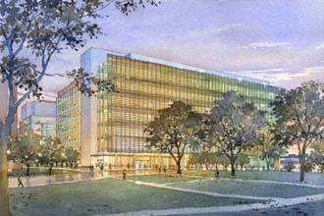
UNC Imaging Research Building
Chapel Hill, NC
Daniel R. Hesington, LEED AP l Structural Option
AE Senior Thesis l Spring 2010
Faculty Consultant l Dr. Thomas Boothby

Slide 2
Existing Building Information
Project Goals
Structural Depth Study
Construction Management Breadth
Outline
Blast Resistant Façade Breadth
Conclusions
Acknowledgements
Questions and Comments

Slide 3
Existing Building Information
Project Goals
Structural Depth Study
Construction Management Breadth
Blast Resistant Façade Breadth
Conclusions
Acknowledgements
Questions and Comments
Existing Building Information

Slide 4
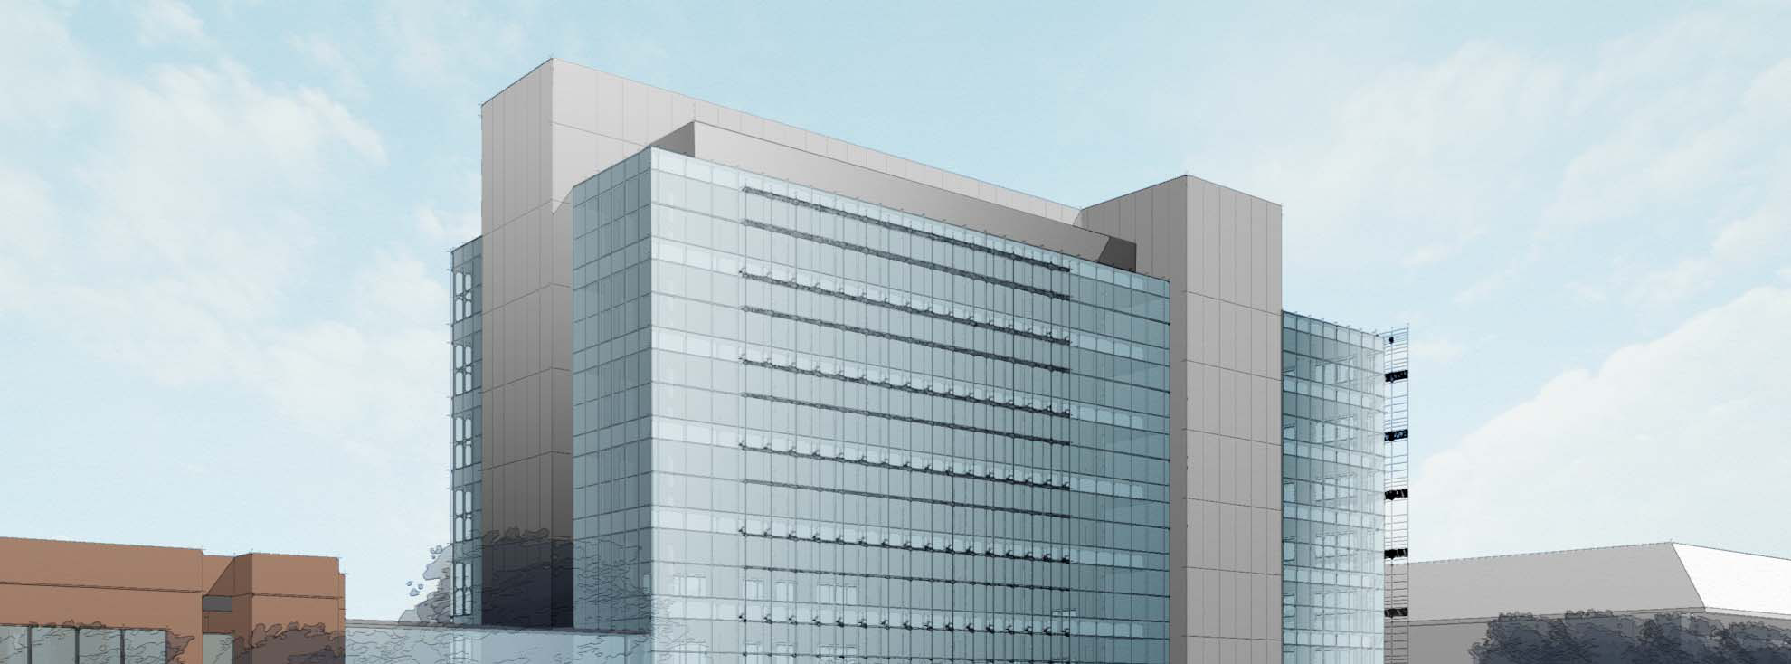
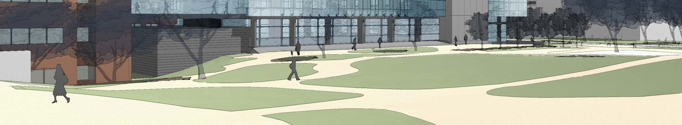
Existing Building Information
Project Goals
Structural Depth Study
Construction Management Breadth
Blast Resistant Façade Breadth
Conclusions
Acknowledgements
Questions and Comments
PH
Location
UNC’s Chapel Hill Campus
Building Statistics
Office/Laboratory/Imaging Equipment
Size l 325,000 sq. ft.
Stories l 8 above grade / 2 below grade = 10 Total + Penthouse
Total Project Cost
$280 million (Estimated)
4-UNIT
FLOORS
TOWNHOUSES
Perspective from Northwest Corner
Credit: Perkins + Will
CELLAR

Slide 5

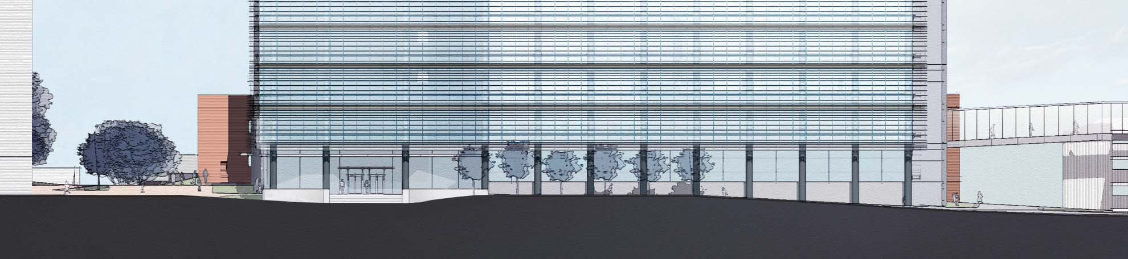
Existing Building Information
Project Goals
Structural Depth Study
Construction Management Breadth
Blast Resistant Façade Breadth
Conclusions
Acknowledgements
Questions and Comments
Architectural Design Concept
Laboratory space and imaging equipment
South Facade
  Aluminum and glass curtain wall
  Horizontal sunshades
North Facade
  Bridge to Lineberger Cancer Center
Concrete stair and elevator cores
South Elevation
Credit: Perkins + Will

Slide 6
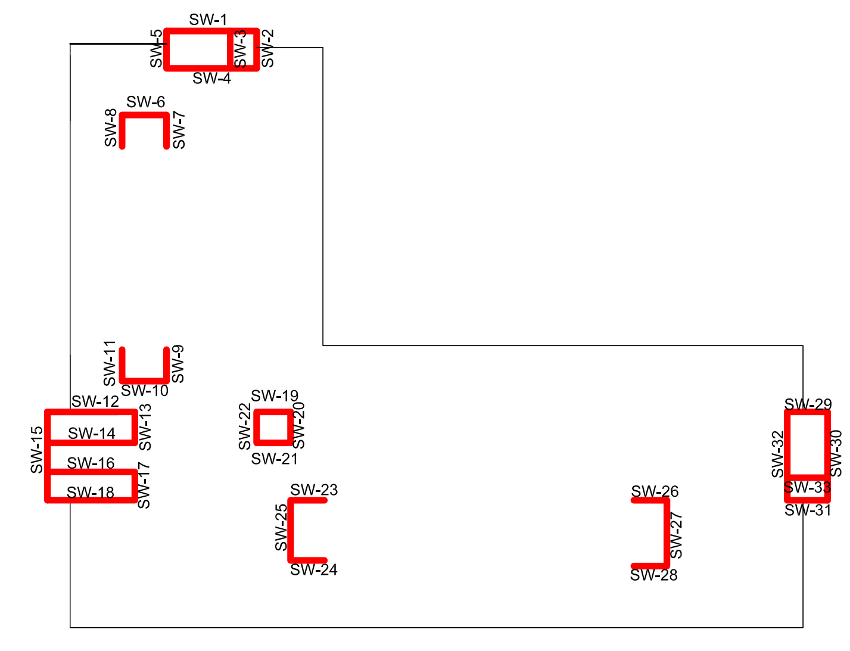
Existing Building Information
Project Goals
Structural Depth Study
Construction Management Breadth
Blast Resistant Façade Breadth
Conclusions
Acknowledgements
Questions and Comments
Structural System
6” thick one-way cast-in-place concrete slabs
Spread, continuous and mat slab foundation system
12” and 16” thick ordinary reinforced concrete shear walls
20”×20” & 24”x24” columns
18”x20” T-Beams
28”x30” Girders
Steel mechanical penthouse structure
Varying concrete strengths l 5 ksi to 10 ksi

Slide 7
Existing Building Information
Project Goals
Structural Depth Study
Construction Management Breadth
Blast Resistant Façade Breadth
Conclusions
Acknowledgements
Questions and Comments
Project Goals

Slide 8
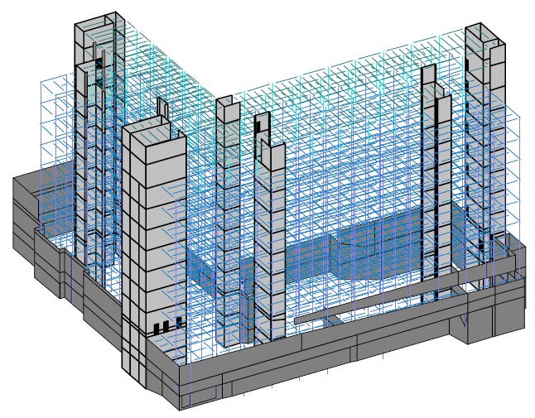
Existing Building Information
Project Goals
Structural Depth Study
Construction Management Breadth
Blast Resistant Façade Breadth
Conclusions
Acknowledgements
Questions and Comments
Problem Statement
Complete concrete structure
Bulky and heavy
  Reduced usable floor area
  Reduced vertical trade space
Time consuming and costly
  Formwork
  Labor
  Construction schedule
Existing Concrete Structure RAM Model

Slide 9
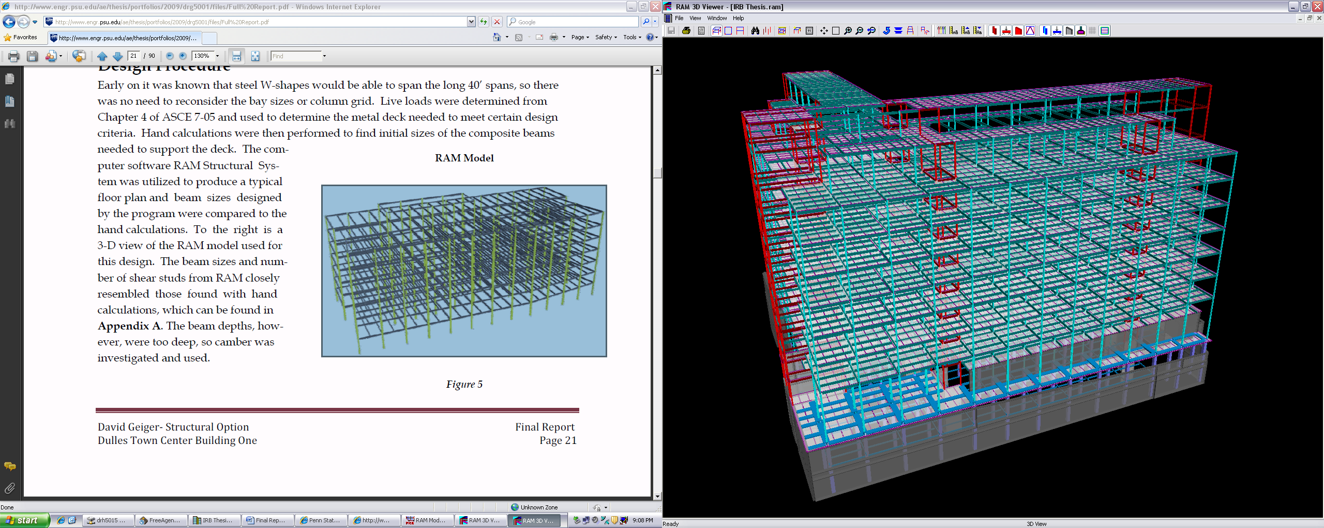
Existing Building Information
Project Goals
Structural Depth Study
Construction Management Breadth
Blast Resistant Façade Breadth
Conclusions
Acknowledgements
Questions and Comments
Structural Depth Study l Gravity system redesign
  Steel framing with composite floor system
Structural Depth Study l Lateral system redesign
  Special concentric braced frames
Construction Management Breadth
  Cost analysis
  Comparison of steel framing to concrete
Blast Resistant Façade Breadth
Steel Redesign RAM Model

Slide 10
Existing Building Information
Project Goals
Structural Depth Study
Construction Management Breadth
Blast Resistant Façade Breadth
Conclusions
Acknowledgements
Questions and Comments
Structural Depth Study

Slide 11
Existing Building Information
Project Goals
Structural Depth Study
Construction Management Breadth
Blast Resistant Façade Breadth
Conclusions
Acknowledgements
Questions and Comments
Design Goals
To maintain the current column layout as much as possible
To design the new composite floor system efficiently so that the total depth of the system is less than the original to free up vertical trade space
Use RAM and confirm designs with hand calculations
To present a design that has a shorter construction schedule and less cost
To follow all codes and standards during the redesign

Slide 12
Table 1 -Gravity Loads
Description | Mulkey | ASCE 7-05
DEAD (DL)
Reinforced Normal Weight Concrete | 150 pcf | 150 pcf
Slab + Deck | 65 psf | 65 psf
LIVE (LL)
Roof | 30 psf | 20 psf
Offices | 50 psf | 50 psf
Public Areas, Lobbies | 100 psf | 100 psf
Laboratories | 100 psf | 60 psf
Corridors, 2nd & Above | 100 psf | 100 psf
Corridors Ground | 100 psf | 100 psf
Stairs | 100 psf | 100 psf
Catwalk | 40 psf | 40 psf
Storage | 125 psf | 125 psf
Heavy File Storage | 200 psf | 250 psf
Mechanical Rooms | 150 psf | 150 psf
Level B1 | 150 psf | N/A
SNOW (S)
Snow | 16.5 psf | 16.5 psf
SUPERIMPOSED (SDL)
Finishes, MEP, Partions | 25 psf | 25 psf
Bathroom Terrazo | 40 psf | N/A
Lobby Terrazo | 60 psf | N/A
Mechanical Courtyard | 300 psf | N/A
3T MRI Room | 250 psf | N/A
7T Sheilding | 75 psf | N/A
Hot Cells | 350 psf | N/A
Water Tank | 350 psf | N/A
Existing Building Information
Project Goals
Structural Depth Study
Construction Management Breadth
Blast Resistant Façade Breadth
Conclusions
Acknowledgements
Questions and Comments
Design Loads
  ASCE 7-05
    Live load values
    Superimposed load values
  Controlling load combination
    1.2 D + 1.6L + 0.5 Lr
Lateral Loads
  Wind
    East/West
    North/South

Slide 13
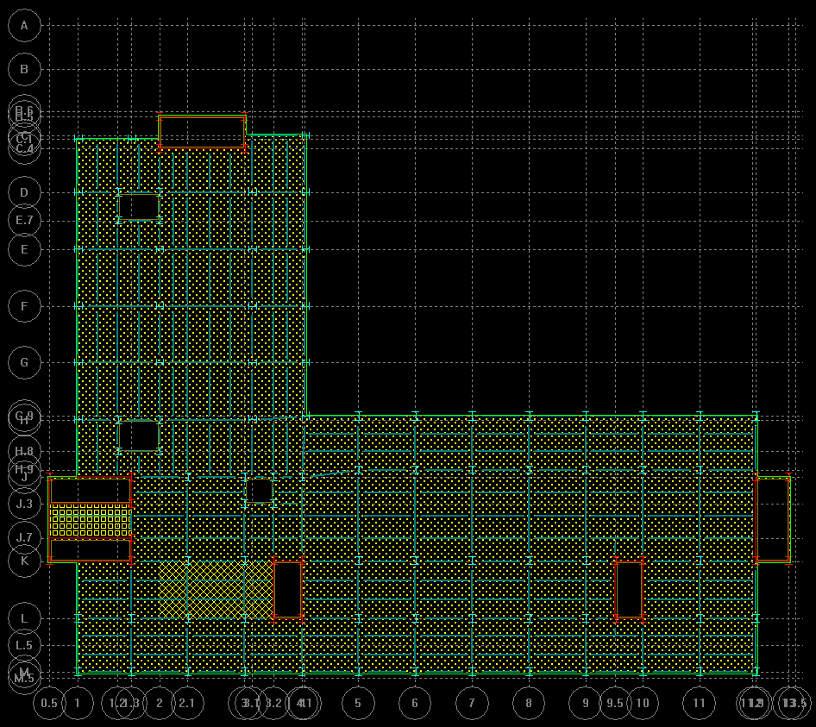
Existing Building Information
Project Goals
Structural Depth Study
Construction Management Breadth
Blast Resistant Façade Breadth
Conclusions
Acknowledgements
Questions and Comments
Typical Floor Load
DL = 25 psf
LL = 100 psf
Const. DL = 25 psf
Const. LL = 50 psf
Mass DL = 25 psf
Reducible
Design Process
  Maintain existing column layout
  Determination of loads
    Area Loads
    Line Loads
  Model in RAM
    Deck Selection
    Layout of Framing
    Braced Frame Locations
  Hand Calculations
Lobby Terrazo
Bathroom Terrazo
Typical Floor Loads

Slide 14
Existing Building Information
Project Goals
Structural Depth Study
Construction Management Breadth
Blast Resistant Façade Breadth
Conclusions
Acknowledgements
Questions and Comments
  Floor System
  Composite metal deck
  Design governed by load, span
  Vulcraft Product Catalog
    2”, 20 gage deck with 4 ¼” lightweight concrete
  Benefits
    Speed of steel construction
    No shoring
    Slight increase in thickness
  Drawbacks
    Shorter spans
Composite Deck Design

Slide 15
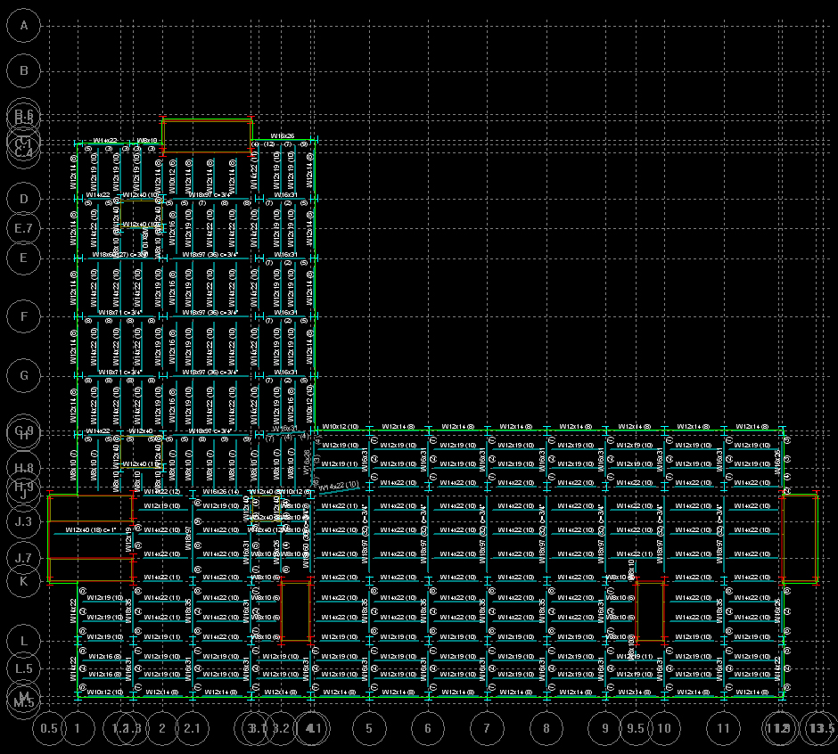
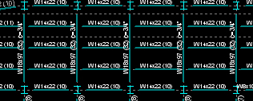
Existing Building Information
Project Goals
Structural Depth Study
Construction Management Breadth
Blast Resistant Façade Breadth
Conclusions
Acknowledgements
Questions and Comments
Gravity Framing
Multiple iterations
Optimization of beams
  Repetition was used
  Typical beam depth– W14’s and W12’s
Girders mostly restricted to W18’s
  Problem area – middle bays
    Optimized shape was a W24 x 68
    Depth reduced to W18 x 97’s w/ c=3/4”

Slide 16
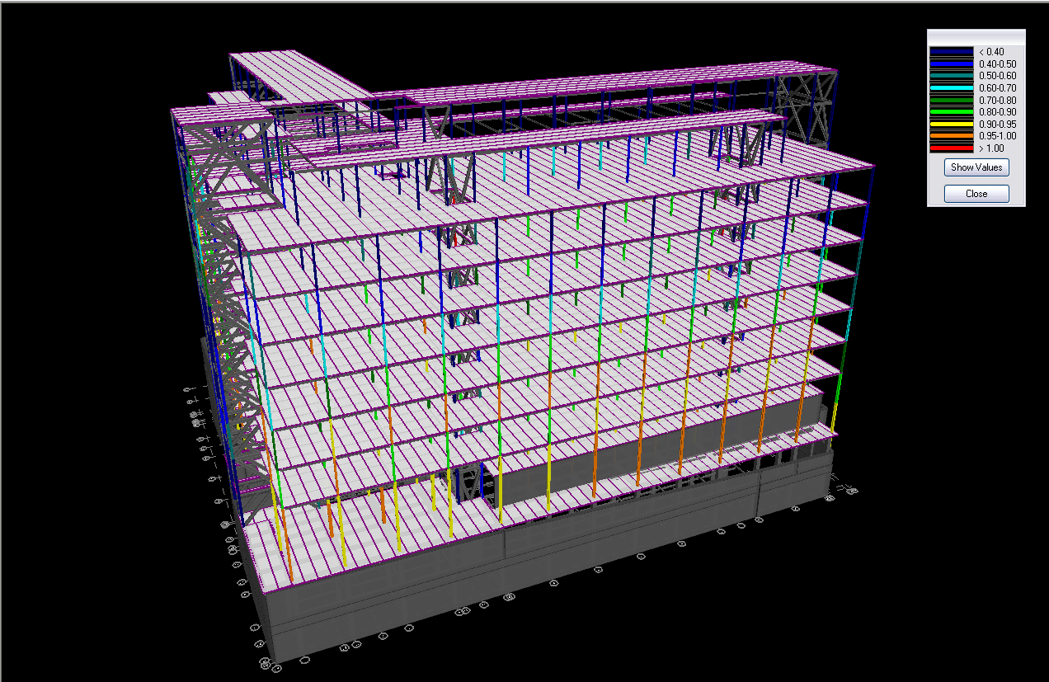
Existing Building Information
Project Goals
Structural Depth Study
Construction Management Breadth
Blast Resistant Façade Breadth
Conclusions
Acknowledgements
Questions and Comments
Gravity Framing
Column layout restricted to current design
  Columns added at corner of shear walls
Multiple iterations
Repetition was used
Column splices between every other level
Gravity columns kept to 14” depth
  Compared to existing 24”x24” and 20”x20” concrete columns
Column Code Check

Slide 17
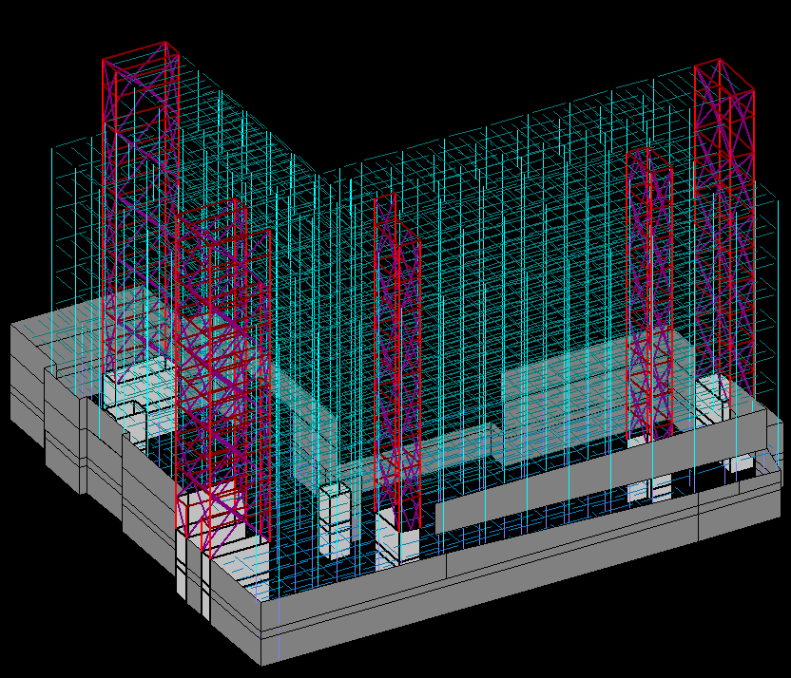
Existing Building Information
Project Goals
Structural Depth Study
Construction Management Breadth
Blast Resistant Façade Breadth
Conclusions
Acknowledgements
Questions and Comments
Lateral Framing
Original design – Ordinary reinforced concrete shear walls
Considered designing connections to steel frame
Chose steel lateral system
Only above grade
Designed in RAM
Multiple Iterations
  Began with moment frames
    Costly
    Too flexible, strength and drift concerns
  Decided to use braced frames

Slide 18
Existing Building Information
Project Goals
Structural Depth Study
Construction Management Breadth
Blast Resistant Façade Breadth
Conclusions
Acknowledgements
Questions and Comments
Lateral Framing
Assumptions and Criteria:
  Rigid diaphragm was modeled at every floor with lateral load assigned to diaphragm
  Load combinations were generated according to relevant codes
  Braces were assumed pinned at each end
  P-Delta effects were taken into account
  Ground level set at floor 1

Slide 19
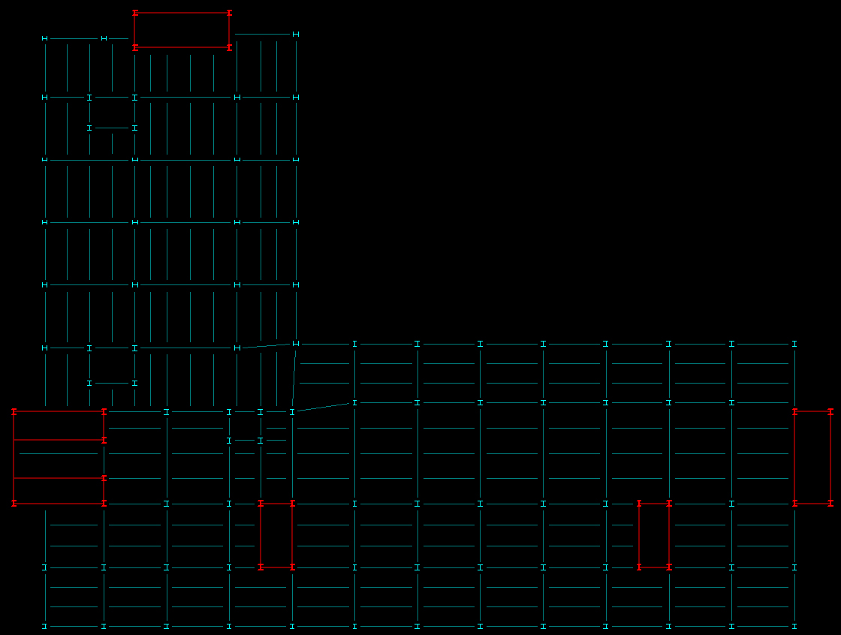
Existing Building Information
Project Goals
Structural Depth Study
Construction Management Breadth
Blast Resistant Façade Breadth
Conclusions
Acknowledgements
Questions and Comments
Lateral Framing
Frame locations originally same as shear walls
Realized not practical
  Some frames around mechanical shafts eliminated
BRBF’s vs. OCBF’s vs. SCBF’s
  BRBF’s
    Not as common, modeling complexity
  OCBF’s
    Lower R value, less ductile
    Benefits - less expensive, less detailing requirements
Lateral Frame Locations

Slide 20
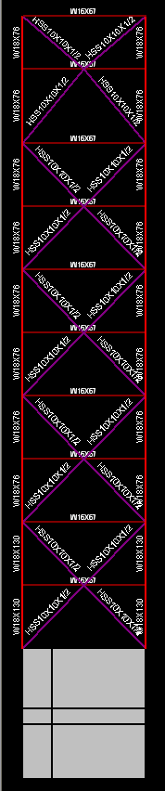
Existing Building Information
Project Goals
Structural Depth Study
Construction Management Breadth
Blast Resistant Façade Breadth
Conclusions
Acknowledgements
Questions and Comments
Lateral Framing
Repetition
Beams and Columns
  W Shapes
Braces
  HSS 10x10x1/2”
Realize does not meet goal of not interfering with architecture
  Door locations
  Columns slightly wider than existing shear walls
Lateral Framing
Special Concentric Braced Frames (SCBF’s)
  R value of 6
  Benefits
    Able to reduce number of frames
  Drawbacks
    Special detailing requirements, more expensive
Final Design
  Modified “X” or 2-story “X”
    Dissipates energy along height of frame
    Braces buckle simultaneously at all floors

Slide 21
Existing Building Information
Project Goals
Structural Depth Study
Construction Management Breadth
Blast Resistant Façade Breadth
Conclusions
Acknowledgements
Questions and Comments
Serviceability
Two criteria
  Wind: h/400
  Seismic: 0.020hsx
    Amplified according to 12.8 ASCE 7-05
Drifts taken from RAM Frame
Inherent Torsion
  But COM and COR were very close

Slide 22
Existing Building Information
Project Goals
Structural Depth Study
Construction Management Breadth
Blast Resistant Façade Breadth
Conclusions
Acknowledgements
Questions and Comments
Impact on Foundation
Initial trials in RAM
Complete redesign was not warranted
Spread footings could be reduced under columns
Mat foundations
  Support lateral frames and imaging equipment
  Size controlled by load from imaging equipment
  Still will encompass over half of building

Slide 23
Existing Building Information
Project Goals
Structural Depth Study
Construction Management Breadth
Blast Resistant Façade Breadth
Conclusions
Acknowledgements
Questions and Comments
Construction Management Breadth

Slide 24
Existing Building Information
Project Goals
Structural Depth Study
Construction Management Breadth
Blast Resistant Façade Breadth
Conclusions
Acknowledgements
Questions and Comments
Site
Small site
Proximity to Lineberger Cancer Center
  Concerns during excavation
  Blasting
Staging concerns

Slide 25
Existing Building Information
Project Goals
Structural Depth Study
Construction Management Breadth
Blast Resistant Façade Breadth
Conclusions
Acknowledgements
Questions and Comments
Table 4.2 - Structural Material, Labor, and Equipment Totals
Steel
Summary | Cost Per Square Foot($/SF) | Total Cost($)
Material Total | $40.26 | $3,351,091.08
Labor Total | $2.09 | $174,227.83
Equipment Total | $1.87 | $155,824.62
Total | $44.22 | $3,681,143.53
Concrete
Summary | Cost Per Square Foot($/SF) | Total Cost($)
Material Total | $24.77 | $2,062,368.33
Labor Total | $32.26 | $2,685,458.12
Equipment Total | $0.95 | $79,250.54
Total | $57.99 | $4,827,076.98
Cost Analysis
Initial square foot cost estimate
  R.S. Means Construction Cost Data online catalog
  Not relevant, uniqueness of building
  “apples to apples” comparison of structure
Detailed estimate
  R.S. Means
  Takeoff from RAM
  Only beams & girders, columns, and lateral frames

Slide 26
Existing Building Information
Project Goals
Structural Depth Study
Construction Management Breadth
Blast Resistant Façade Breadth
Conclusions
Acknowledgements
Questions and Comments
Schedule Analysis
Compared structural components only
Above grade
Linear analysis
Crews based on RS Means
Steel Concrete
        225 days < 315 days
Can be reduced
  Addition of more crews
  Overlapping of activities

Slide 27
Existing Building Information
Project Goals
Structural Depth Study
Construction Management Breadth
Blast Resistant Façade Breadth
Conclusions
Acknowledgements
Questions and Comments
Blast Resistant Façade Breadth

Slide 28
Existing Building Information
Project Goals
Structural Depth Study
Construction Management Breadth
Blast Resistant Façade Breadth
Conclusions
Acknowledgements
Questions and Comments
Design Process
Two major codes
  GSA/Interagency Security Committee Security Design Criteria
  DoD Unified Facilities Code UFC 4-010-01, Minimum Antiterrorism Standards for Buildings
Standoff distance = 50 ft
Equivalent charge weight = 220 lbs
Using ASTM F 224-03
  3-second equivalent design pressure = 250 psf
USDOT Equivalent Charge Weight

Slide 29
Existing Building Information
Project Goals
Structural Depth Study
Construction Management Breadth
Blast Resistant Façade Breadth
Conclusions
Acknowledgements
Questions and Comments
Glass Options
Heat Strengthened vs. Annealed vs. Fully Tempered
Load Resistance
  LR = 2 x 1.8 x NFL > 3-sec design pressure of 250 psf
    NFL – Non-Factored Load
    2 lites, 1.8 for heat strengthened
Plate size = 66” x 24”
Multiple Iterations
5/16” heat strengthened, laminate insulated glass
  LR = 18kPA = 376.2 psf > 250 psf
Mullions and frames deflection limit of L/160
Connections need to withstand 2 times capacity of glass
Non-Factored Load Chart

Slide 30
Existing Building Information
Project Goals
Structural Depth Study
Construction Management Breadth
Blast Resistant Façade Breadth
Conclusions
Acknowledgements
Questions and Comments
Conclusions
Reduced Floor System Depth
    30” to 24 ¼”
Designed steel lateral system
Maintained architectural concepts
    Reduced columns sizes in gravity framing
    Redesigned lateral system deeper than existing shear walls
Cost of steel redesign less than concrete
  3.7 vs 4.8 million
Reduced schedule time to complete superstructure
Redesigned façade for blast resistance

Slide 31
My friends and family for their support and encouragement
Mulkey Engineers and Consultants
  Valoree Eikinas
  Adam Rowland
Perkins + Will
  Chris Nesbit
Newcomb and Boyd
Choate Construction
University of North Carolina
The Pennsylvania State University
  Dr. Thomas Boothby
  Prof. M. Kevin Parfitt
  Prof. Robert Holland
  Dr. Louis Geschwindner
  The entire AE faculty
Existing Building Information
Project Goals
Structural Depth Study
Construction Management Breadth
Blast Resistant Façade Breadth
Conclusions
Acknowledgements
Questions and Comments
Acknowledgements

Slide 32
Existing Building Information
Project Goals
Structural Depth Study
Construction Management Breadth
Blast Resistant Façade Breadth
Conclusions
Acknowledgements
Questions and Comments
Questions and Comments

